Slide 1

COmputeR ScIenCe wait-list User Stories Presentation
CS410 Red Team

Slide 2





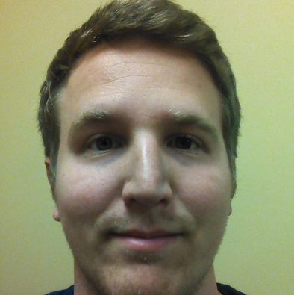

Team CORSICA
Anthony Baron
Algorithms
Nicholas LoGioco
Algorithms
Latimer Gerle
Database
Bitaseme Mboe
Interface
Lookmai Rattana
Front End Developer & User Interface
Patrick DeBerry
Reporting & Analyses
Notes:
This is us…..

Slide 3
Outline
User Stories:
Administrator
Advisor
Scheduler
Student
Visitor
Notes:
We will be going over these user stories…..

Slide 4
Administrator User Story
I need to…
have the ability to control / view all course wait-list queues
be able to manipulate students on all course wait-list queues (move / delete / etc.)
view course wait-list statistics for analytical purposes
do everything an advisor user can do
update course capacity as it pertains to the wait-list system (caps / overrides)
I need to…
remove courses as available options for student users
add new course wait-lists as available options for student users
view advisor activity on Corsica
add / delete schedulers
add / delete advisors

Slide 5
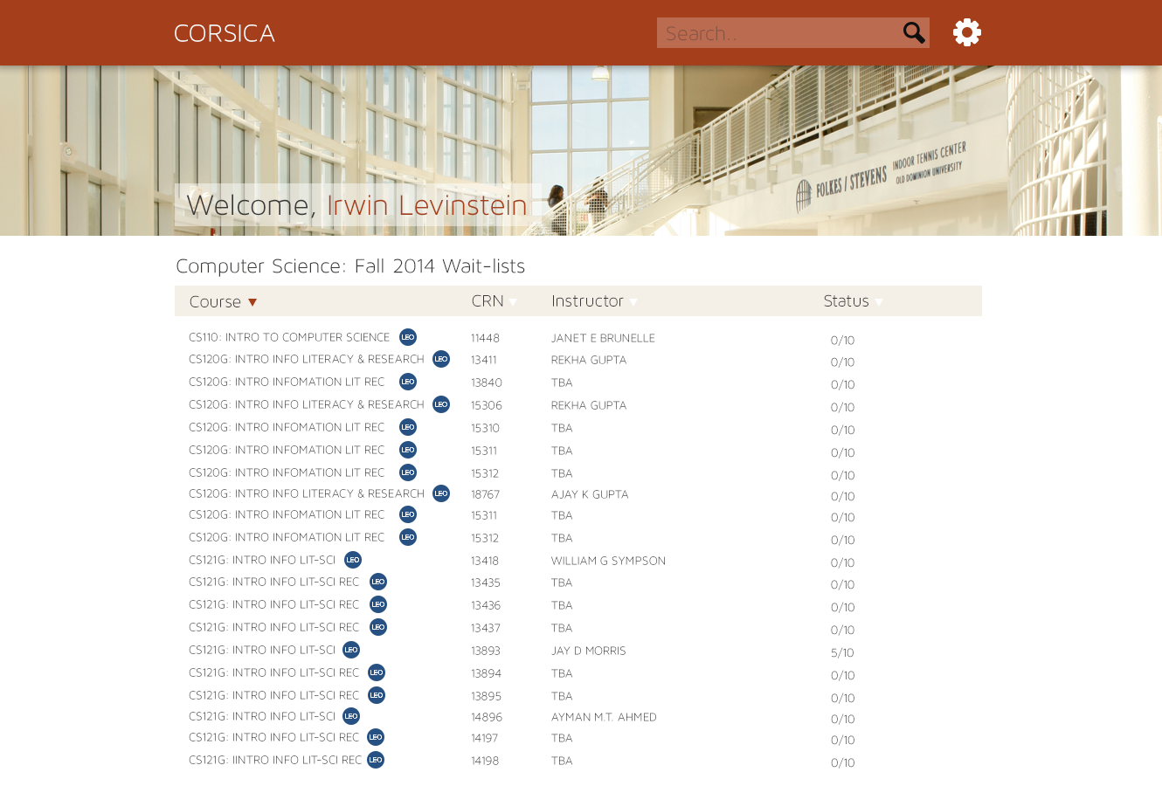
Administrator: Dashboard 1
Notes:
Administrator: Dashboard 1 Home page after log in….

Slide 6
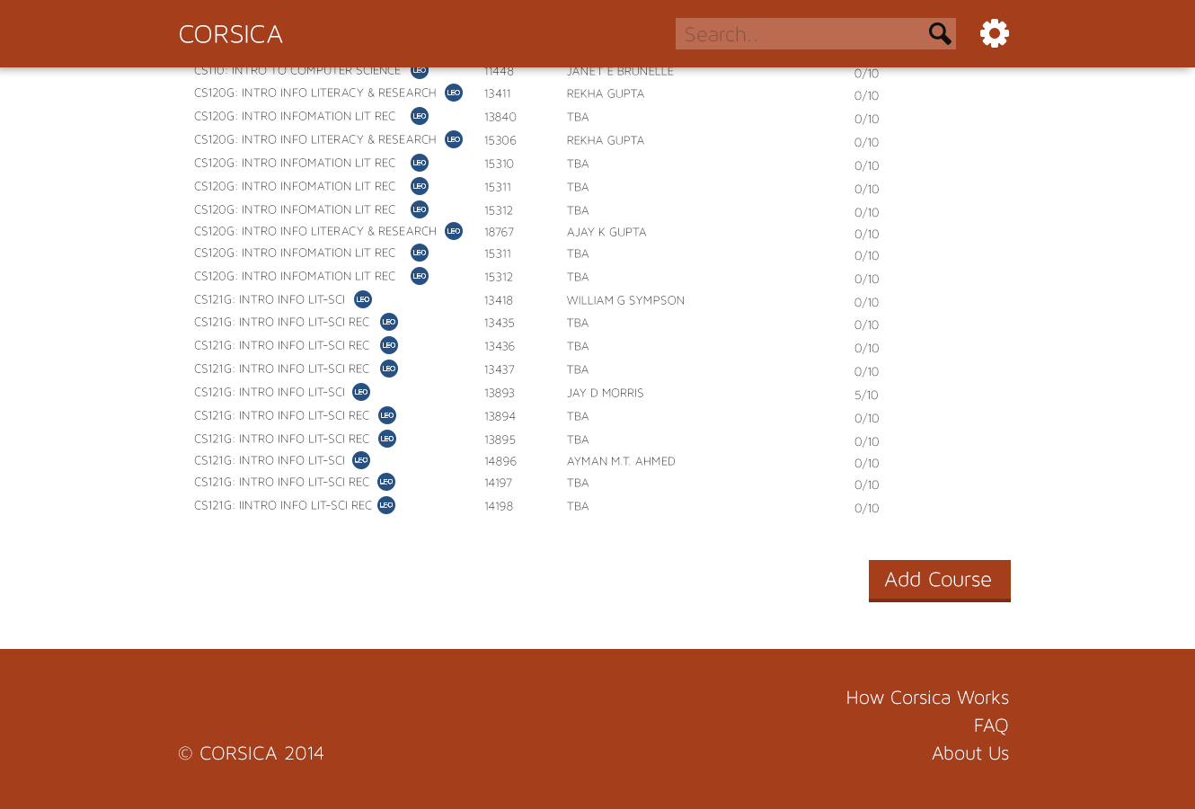
Administrator: Dashboard 2
Notes:
Administrator: Dashboard 2
Admin has scrolled to bottom and sees Add course
If wanted, may add course by inputting all require info: course name, crn(s), labs, recitations (if applicable), etc.

Slide 7
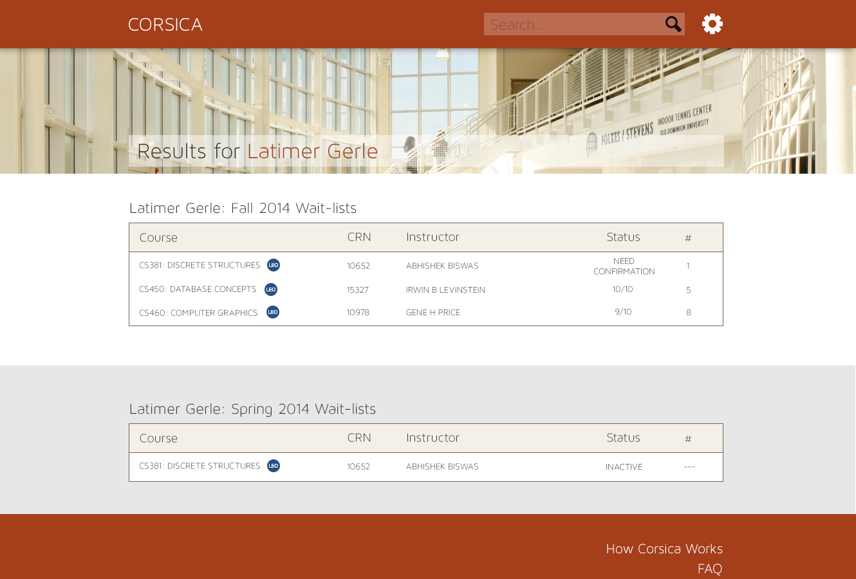
Notes:
Administrator: Search
Admin has searched for a particular student
All information about the current wait-lists for that Student are pulled up

Slide 8
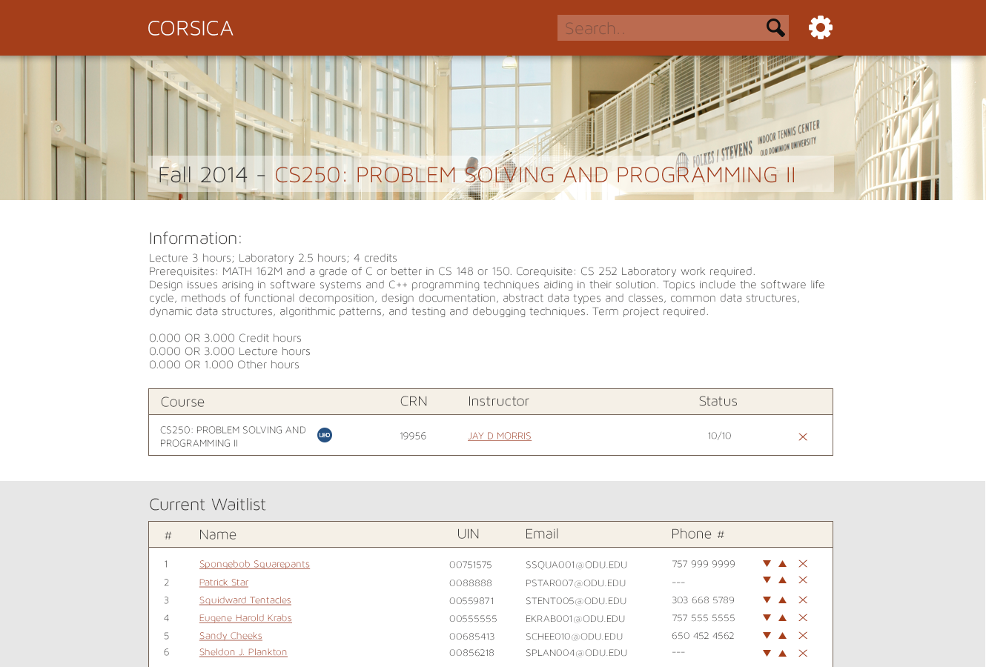
New Process Flow
Notes:
Administrator: wait-list detail
Admin has pulled up the wait list for a particular course (CS 250 in this case)
All the information about that wait list is pulled
…how many students are on there
…student names and their position
....student UINs and their emails
….ability to move a student up or down in queue (or remove them)

Slide 9

Advisor User Story
I need to…
login to CORSICA
view respective departmental wait-list queues
view wait-lists that student is on
search for a course
search for a student
move students on a wait-list
delete students off a wait-list
I want to…
view a filterable list of courses that do not have wait-lists
view a filterable list of courses that do have wait-lists
view CORSICA homepage and product details

Slide 10
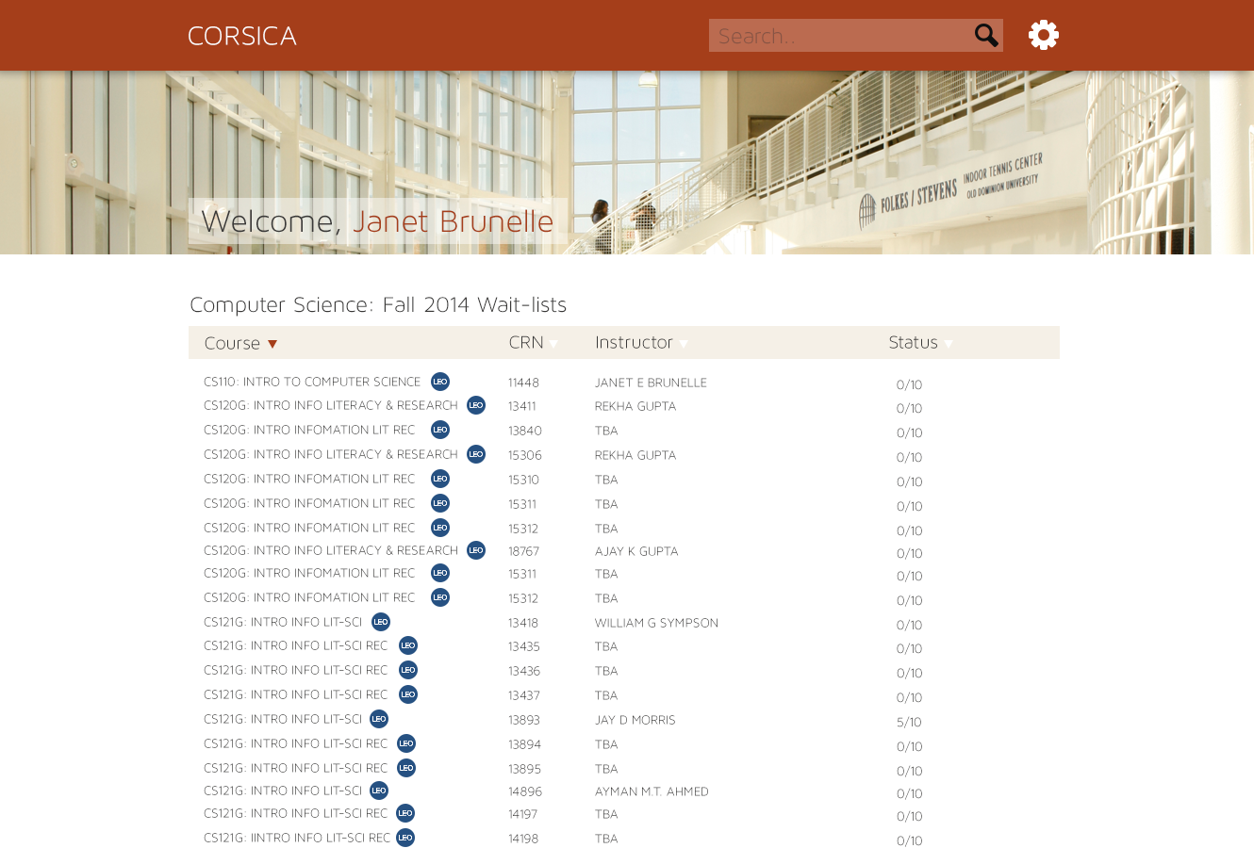
Solution Goals
Notes:
Advisor: Dashboard 1
Advisor logs in
Home page…

Slide 11


Major Functional Component Diagram
Notes:
Advisor: Search
Advisor searches for a student
wait-lists that that student are enrolled in show up

Slide 12
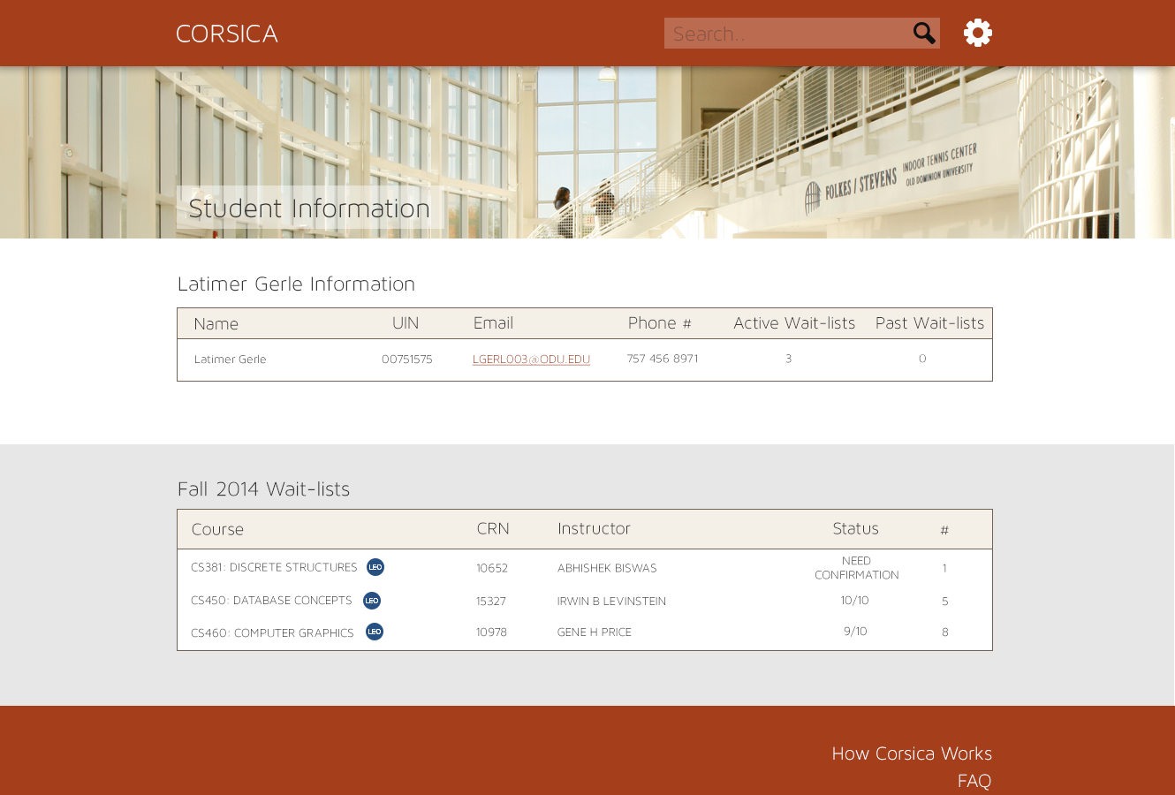
Hardware Requirements Identified
Notes:
Advisor: Student Detail
Pulls up student details
Their name, UIN, email, active wait-list #, past wait-lists and shows current wait-lists

Slide 13

Software Requirements Identified
Notes:
Advisor: wait-list Detail
Searches for a particular course wait-list
Info about the list is pulled
How many students
Student info
Can manipulate students

Slide 14
Scheduler User Story
I need to…
view wait-list for courses
query details about a wait-list
view amount of students on a wait-list after registration ends
view course wait-list statistics for analytical purposes
open wait-list for a course
close wait-list for a course
I want to…
filter course list

Slide 15
Software Details & Logic Approach
Notes:
Scheduler: Dashboard 1
Home page after log in

Slide 16
Software Details & Logic Approach
Notes:
Scheduler: Dashboard 2
Scheduler has scrolled to bottom and sees Add course
If wanted, may add course by inputting all require info: course name, CRN(s), labs, recitations (if applicable), etc.

Slide 17
Software Details & Logic Approach
Notes:
Scheduler: Search
Scheduler searches for a student
wait-lists that that student are enrolled in show up

Slide 18
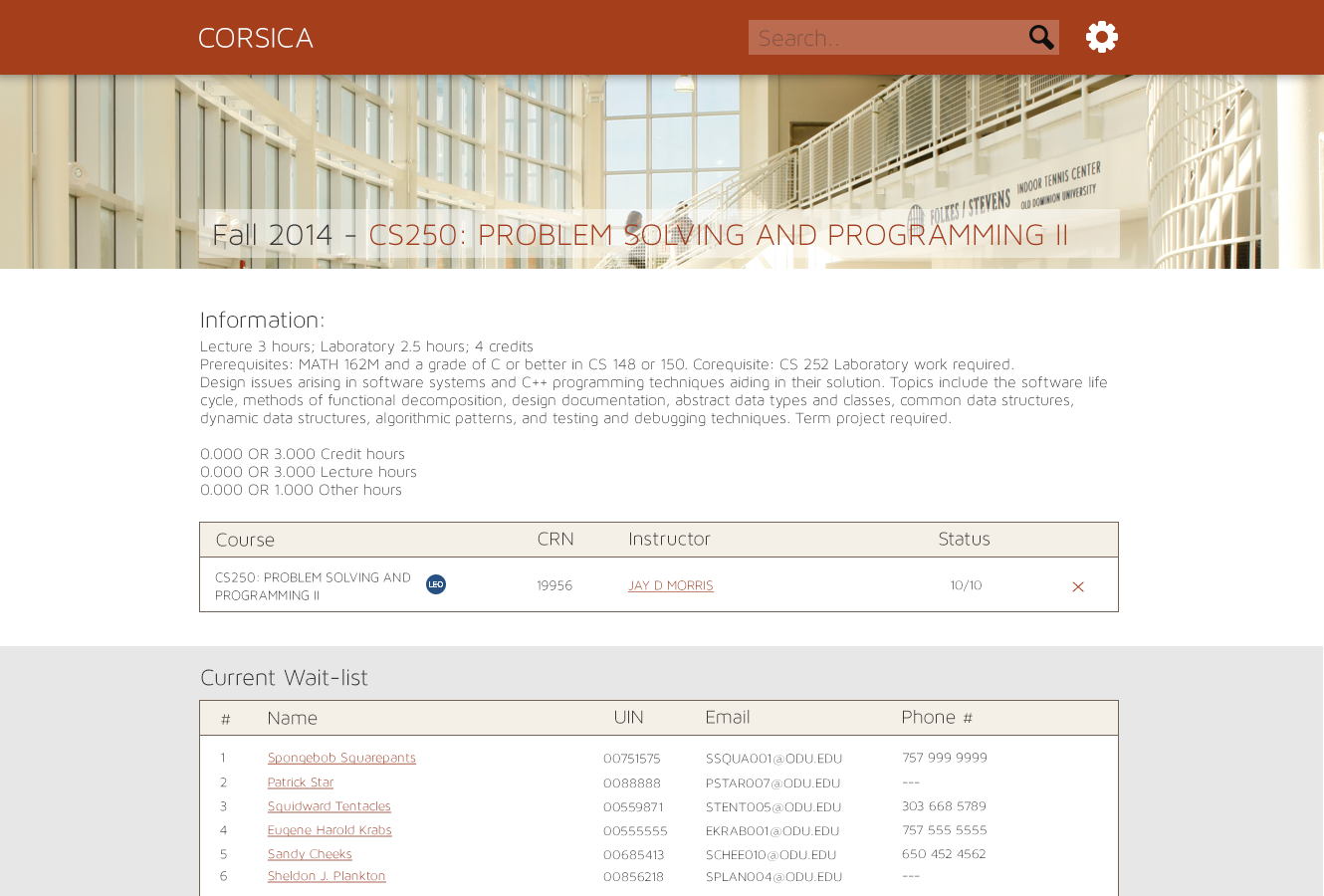
Algorithm: Load Enrollment Data Files
Notes:
Scheduler: wait-list Detail
Searches for a particular course wait-list
Info about the list is pulled
How many students
Student info
Can delete wait-list

Slide 19
Student User Story
I need to…
wait-list myself for one course section
wait-list myself for more than one course section
add myself to multiple wait-lists
remove myself from a wait-list
be notified when there is an open seat and I can register
I want to…
view my position on the wait-list/wait-lists I’m currently on
be given a sufficient amount of time in which to register
be provided with simple instructions regarding how the wait-list works

Slide 20
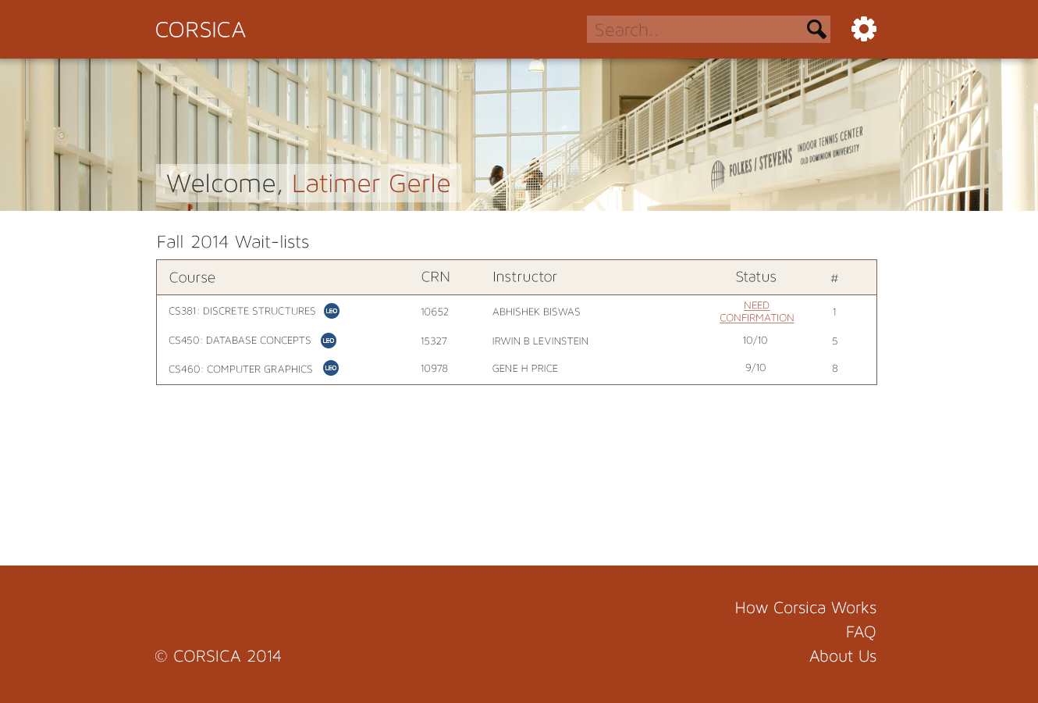
Algorithm: Check for Open Seats
Notes:
Student: Dashboard 1
Home screen after log in

Slide 21
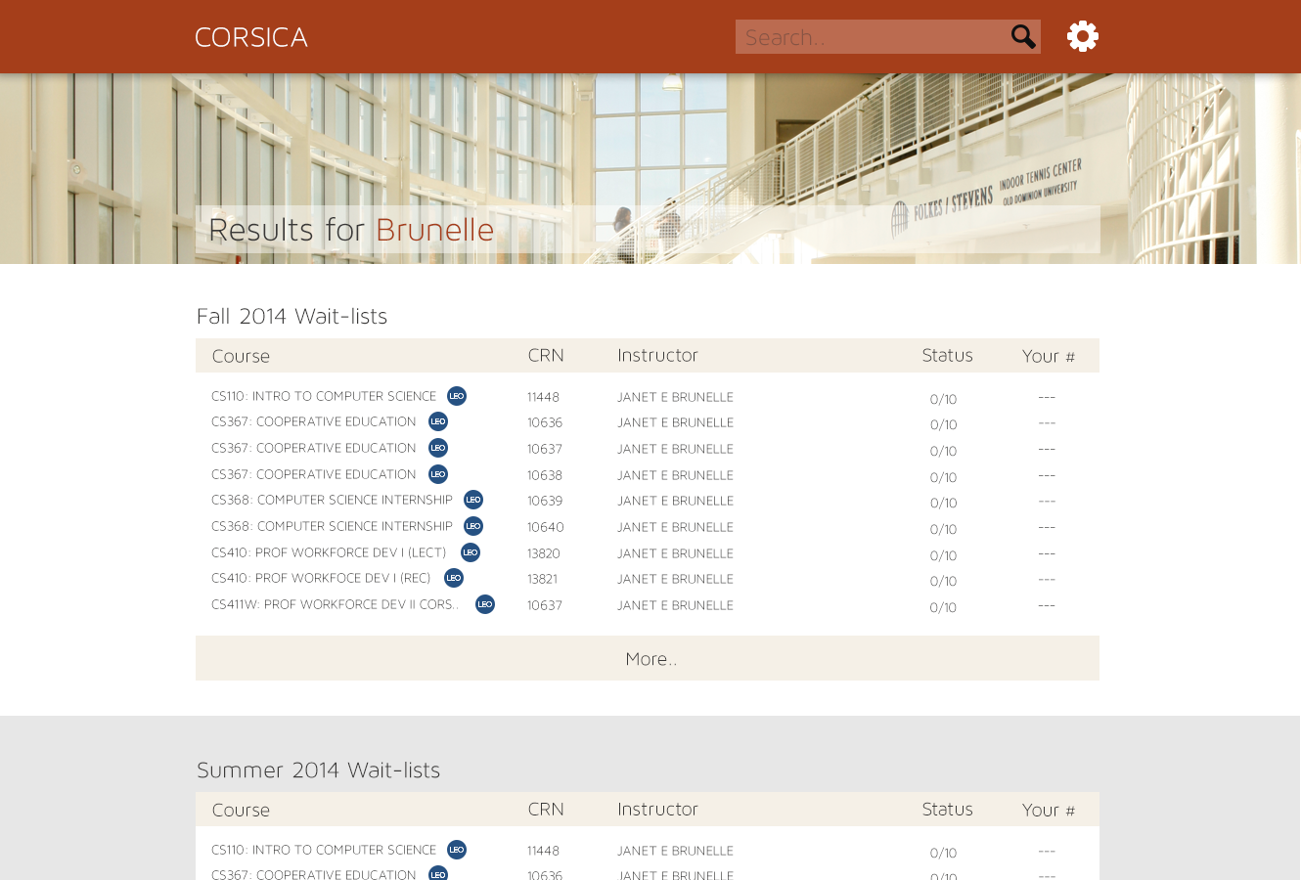
Algorithm: Add Student to wait-list
Notes:
Student: Search
Student has search for a teacher
Current wait-lists for that teacher and their courses are pulled

Slide 22
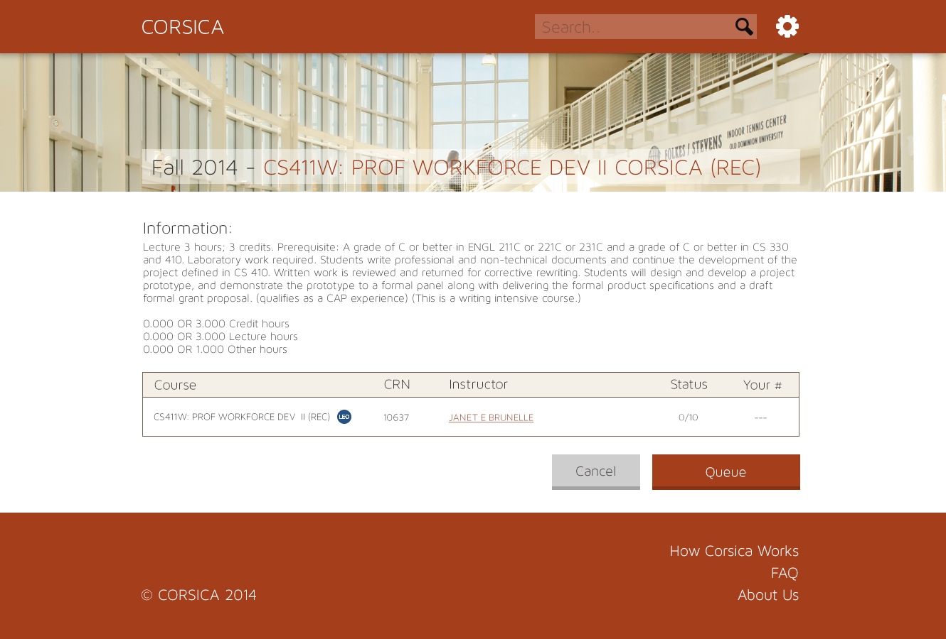
Notes:
Student: wait-list sign up
After finding desired wait-list they can choose to queue into the wait-list

Slide 23
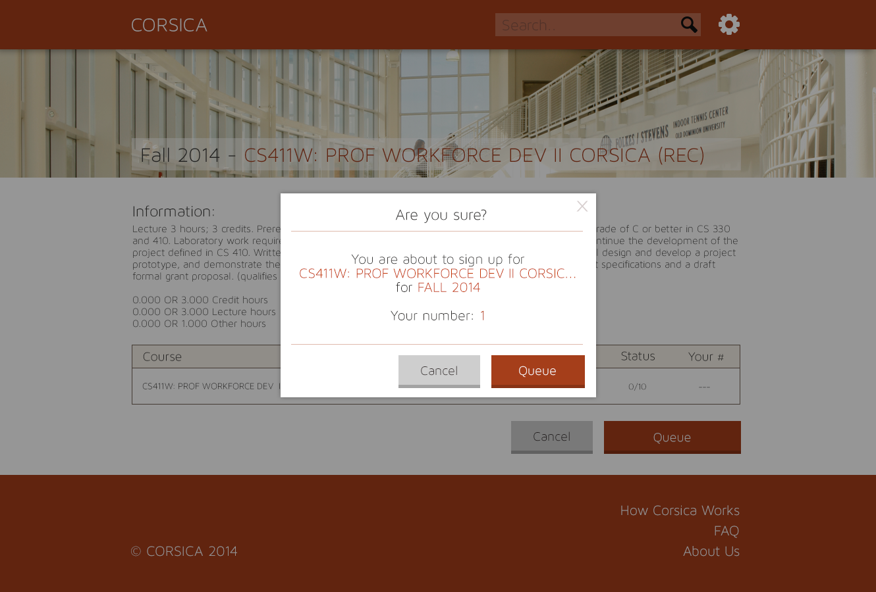
Algorithm: Drop Student from wait-list
Notes:
Student: Confirmation
After clicking Queue
Pop up box notifies them of their sign up on the wait-list and their position, NOT THE COURSE!!!!! (they pissed about this last time)

Slide 24
Visitor User Story
I need to…
have access to login function
I want to…
view page ‘About Us’
view page ‘Overview’’
view page ‘Deliverables’
view page ‘Presentations’

Slide 25
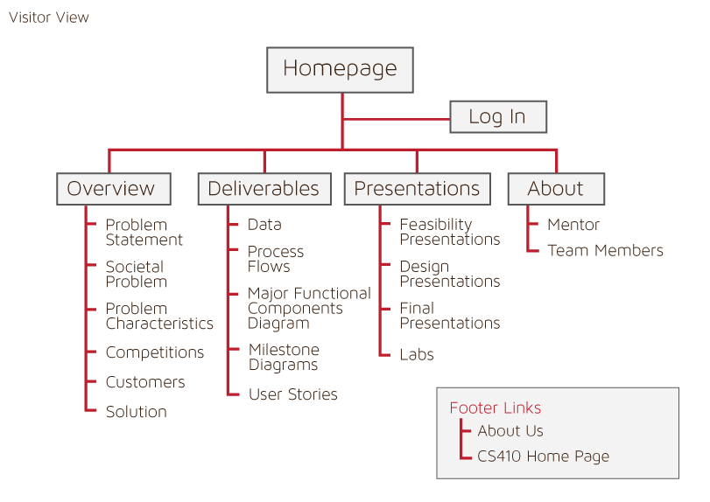
Notes:
Go through all that…

Slide 26
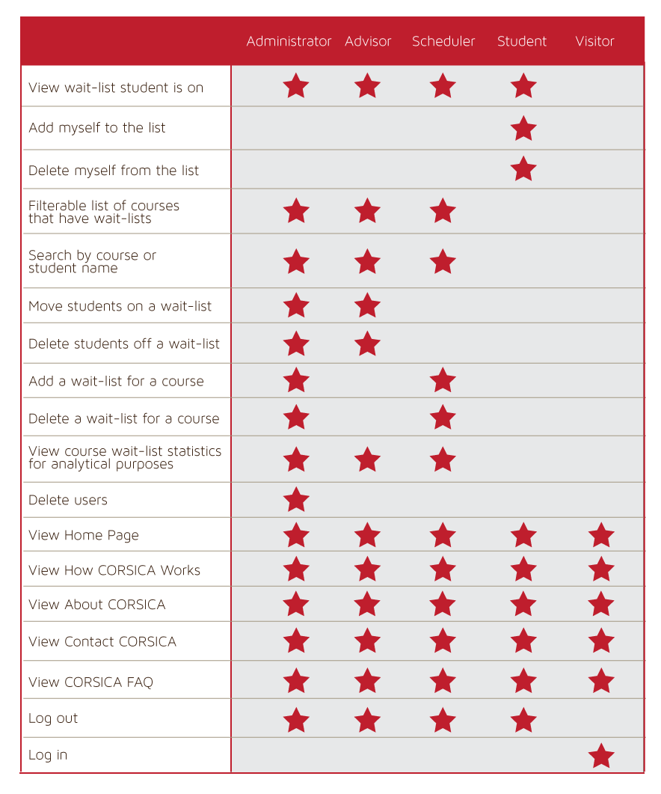
User Commonalities

